Slide 1

ECEN 3593-001 Computer Organization
Lecture #31
2 April 2021

Slide 2


Agenda
Class Announcements
Course Project discussion
Chapter 5

Slide 3
Class Announcements
Reading assignment for the week
“Computer Organization and Design, The Hardware / Software Interface, RISC-V edition,” by David Patterson and John Hennessy
ISBN 978-0-12-812275-4
Chapter 5, “Large and Fast: Exploiting Memory Hierarchy”
pages 364-410 (sections 5.1 thru 5.4)
Zoom OH today 2:00 to 3:00 - https://cuboulder.zoom.us/j/4317981384

Slide 4
Class Announcements
Phases 5 and 6 are in the deduction period – 1%/day
Phase 7 is in the deduction period – 4%/day
Pause extended through last Sunday, on all Phases
Phase 8 is posted
Target Date Sunday, April 4 at 10:00 PM
Bonus 1%/day, deduction 4%/day
Homework #4 is now due Monday, April 5 at 10:00 PM

Slide 5
Class Project
A new document Class Project Phase 8 – MEMCTL Design is posted in Slack and on Canvas
This includes sample code which you may freely use
Note that some signal names may need to be changed

Slide 6
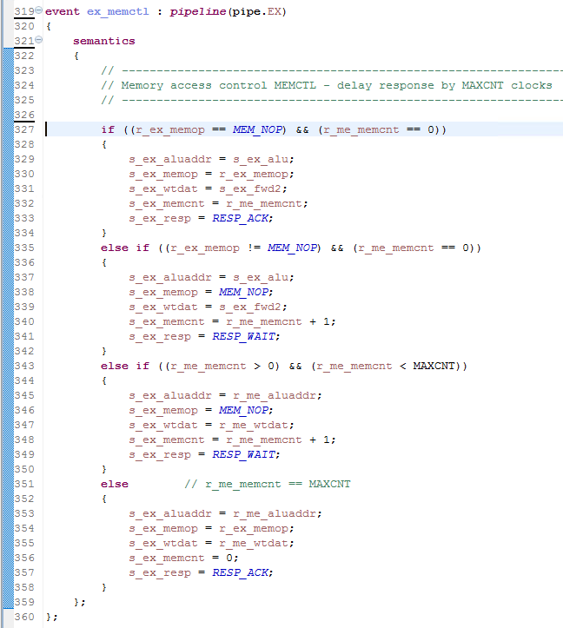
Class Project
Every output should be assigned in every case
All cases must be handled

Slide 7
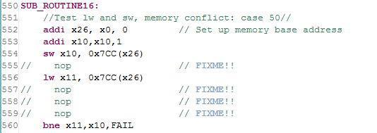
Class Project – Phase 8
First Memory Test – case 50
Exercises three things
Forwarding to store
Memory write to memory read
Load hazard
Make sure store works first – use Memory Monitor (as_data)
If jump to FAIL but x10 = x11, likely failure in load hazard implementation

Slide 8
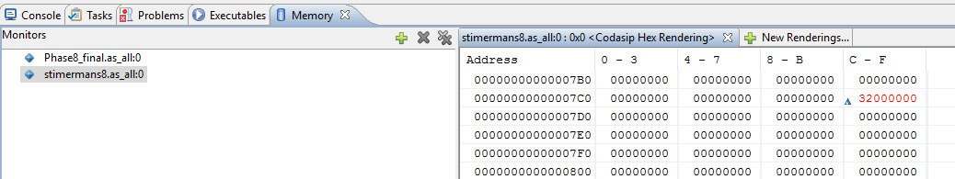
Class Project – Phase 8
Verify the sw first with the Memory Monitor
Look at address 1996 (0x7CC)
Step until it changes to 50 (0x32)
If it doesn’t change, store is not working
Make sure you are looking at the right project!

Slide 9
Class Project – Phase 8
If the store works and the load gets the wrong data (especially 0), the load hazard logic is likely to be incorrect
Check the generation of the load hazard detection (book page 303)
Check the usage of load hazard
Stall IF and ID
Insert the bubble in EX

Slide 10
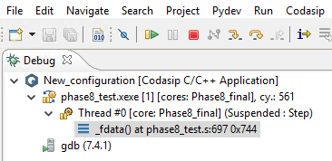
Class Project – Phase 8
Successful completion requires a final cycle count of 561

Slide 11
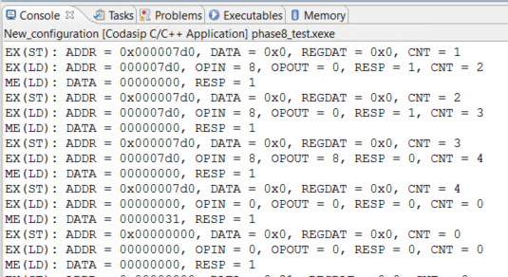
Class Project Phase 8 - - -info 8,9,10 Display
- -info 8 – EX stage address
Address
r_ex_memop
s_ex_memop
s_ex_resp
r_me_memcnt
Others are LD (9) and ST(10) data
Must edit ca_utils to match Figure 9 in the document

Slide 12
Class Project
Questions??

Slide 13
Cache’s The BIG Picture
Caching is perhaps the most important example of one of of the Eight Great Ideas of Computer Architecture: Performance via Prediction
Memory hierarchies take advantage of temporal locality by keeping more recently accessed items closer to the processor, such as the cache
Memory hierarchies take advantage of spatial locality by moving blocks consisting of contiguous words in memory to upper levels of the hierarchy
Would a cache block of 1 or 4 take better advantage of spatial locality?
If the hit rate is high enough, the memory hierarchy has an effective access time close to that of the highest/fastest level and equal in size to that of the lowest/largest level
In most implementations, the memory is a true hierarchy in that the data cannot be present in level i unless it is also present in level i+1

Slide 14
Critically Important Discussion
The following set of slides are critically important
This material will be a big part of Homework #5, Project Phase 10 and the Final Exam
We will initially look only at reads
We will look at the simplest Cache structure, referred to as a Direct Mapped Cache

Slide 15
Cache Structure
Memory is a set of locations, each of which is a line or block
Each line contains one or more words
The Cache also consists of a number of lines
The same word is always in the same position in a line in the Cache and Memory
Data is moved between the memory and the Cache in units of a full line
…
Main Memory
Word A
Block/Line
Block/Line
Cache
Word A

Slide 16
Structure of the Address
The address from the processor is divided into 4 fields
Byte offset – selects the byte in a word
Block offset – selects the word in a block/line
Index – selects the block/line in the Cache
Upper Address – remaining bits
Upper Address + Index select the block/line in Main Memory
31
0
Upper
Index
Block
B

Slide 17
Using the Address
Upper + Index selects Memory block
Block offset selects the word
Index selects the Cache block
Select Block
…
Main Memory
Address
Upper
Ind
Off
B
Word A
Block/Line
Select Block/Tag
Block/Line
MUX
Cache
Word A
Read Data

Slide 18
Key Questions to Answer
Is the Data we want in the Cache?
If so, where is it?
Each Cache line corresponds to a Memory line
The Index field of the address selects one Cache line – if the data is in the Cache, it will be in that line
Need to know which Memory line is currently in each Cache line
Add another entry to each Cache line, called the Tag
The Tag holds the Upper Address of the Memory line currently in the Cache line

Slide 19
Identifying Cache Data
Need to know two key things on an access:
Is the data in the Cache?
If so, where is it?
Add a Tag to each cache block
Select the Tag with the Index
Compare to the Upper Address
HIT if a match
MISS if no match
If HIT, data is in this Cache line
Select Block
…
Main Memory
Address
Upper
Ind
Off
B
Word A
Block/Line
Select Block/Tag
Tag
Block/Line
Tag
Tag
Hit
Cmpr
Tag
Cache
MUX
MUX
Tag
Tag
Word A
Tag
Tag
Read Data

Slide 20
Loading the Tag
How is the Tag value loaded?
Whenever the Cache line is updated, the Tag is written with the Upper Address of the current operation
The Tag is always the Upper Address of the Memory line which is currently in that Cache line

Slide 21
Address Field Widths
Byte Offset = log2(bytes/word)
4 bytes/word => Byte Offset = 2 bits
Block Offset = log2(words/block)
8 words/block => Block Offset = 3 bits
Index = log2(number of lines/blocks in Cache)
If Cache = 4096B, 4 bytes/word, 8 words/block
Block = 32B
Cache = 4096B/32B = 128 Blocks
Index = 7 bits
Upper Address = 32 – 7 – 3 – 2 = 20 bits

